Slide 1
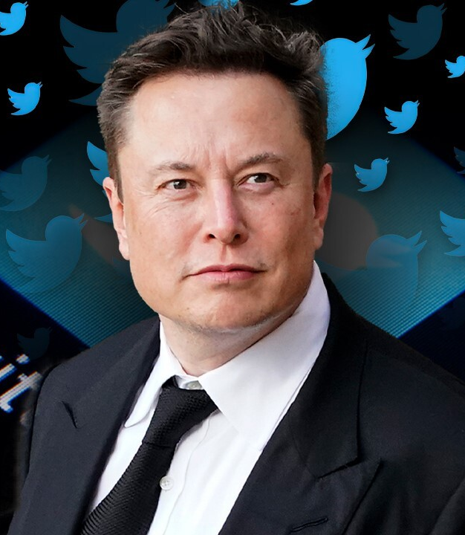


My Inspiring Leader
“When something is important enough, you do it even if the odds are not in your favor.”

Slide 2
Introduction
Elon Musk is a South African-born entrepreneur, business magnate, and visionary who has made a significant impact on a wide range of industries.
Musk is known for his ambitious goals, innovative ideas which have led to groundbreaking achievements in sustainable energy, space exploration, and transportation.

Slide 3
Companies of Elon Musk
SpaceX
Private American aerospace manufacturer and space transportation services company
Founded by Elon Musk in 2002.
Designs, manufactures, and launches advanced rockets and spacecraft.
Goal of enabling the colonization of Mars
Tesla
Tesla, Inc. is an American electric vehicle and clean energy company.
Designs and manufactures electric cars, energy storage systems, and solar products.
Twitter
Twitter is a social media platform founded in 2006.
Elon Musk is an active user of Twitter, with over 63 million followers.
Use platform to share updates on his companies, engage with his followers, and even make news announcements.
3

Slide 4
Five Leadership Qualities
Having a vision
Love the brand like a religion
Look into future
See Potential
Love your brand
Being Passionate
Pursue goals
Make them happy
Working for a greater good
Be obsessed and obsessive
Tesla
SolarCity
SpaceX
Dedication to work
4

Slide 5
Leadership Lessons
Be Collaborative
Be Decisive
Be Creative
Be Comfortable with change
Encourage Innovation
5

Slide 6




Thank you
“ WHEN I WAS IN COLLEGE, I WANTED TO BE INVOLVED IN THINGS THAT WOULD CHANGE THE WORLD.
NOW I AM ”
Rishav Kumar
22mcc20039@cuchd.in
+91 7018338172

